Slide 2
Dr. Raeisi
Assistant Professor of
Medical Oncology & Hematology

Slide 3
Metastatic TNBC

Slide 4
Triple-negative breast cancer (TNBC):
lack expression of the estrogen receptor (ER), progesterone receptor (PR), and human epidermal growth factor receptor 2 (HER2).
<1 percent expression of ER and PR as determined by immunohistochemistry (IHC)
HER2, either 0 to 1+ by IHC, or IHC 2+ and fluorescence in situ hybridization (FISH) negative (not amplified)

Slide 5
approximately 15 percent of breast cancers diagnosed worldwide
Compared with hormone receptor-positive breast cancer, TNBC is more commonly diagnosed in women younger than 40 years.
TNBC appears to be relatively more common among black women compared with white women.

Slide 6
Risk factors associated with the diagnosis of TNBC
Positive BRCA mutation status
Up to 20 percent of patients with TNBC harbor a breast cancer susceptibility gene (BRCA) mutation, particularly in BRCA1.

Slide 7
Any patient with triple-negative disease should be offered a referral to a genetic counselor to discuss BRCA germline testing.
Moreover, any patient age 60 years or younger with TNBC should undergo BRCA germline testing.

Slide 8
Premenopausal status
Premenopausal status has been associated with increased incidence of TNBC diagnosis as compared with postmenopausal status.

Slide 9
TNBC tends to behave more aggressively than other types of breast cancer.

Slide 10
Immunogenic potential of TNBC
TNBC has been shown to have consistently elevated TILs in contrast to other subtypes.
High TILS are more frequent in TNBC (30%) compared to HER2-positive (19%) and luminal tumours (13%).

Slide 11
Immunogenic potential of TNBC
It is recognised that TNBC typically has higher levels of programmed cell death ligand (PD-L1) expression in contrast to other subtypes of breast cancer.
PD-L1 has an important role in regulating our immune system.

Slide 12
Immunogenic potential of TNBC
TNBC has a relatively high tumour mutational burden (TMB) in contrast to other histological subtypes of breast cancer.
Higher levels of TMB results in greater neoantigen expression and presentation to our immune cells enhancing our immune response.
The Food and Drug Administration (FDA) has recently licensed pembrolizumab for the treatment of high TMB tumours (> 10 mutations/Megabase) with the FoundationCDx assay as a companion diagnostic.

Slide 13
METASTATIC DISEASE
Only 5% of patients with TNBC present with de novo metastatic disease. The majority of patients unfortunately relapse following treatment with curative intent.
The biological features of TNBC result in a unique clinical phenotype. It is characterized by a propensity for visceral and brain metastases, absence of bone metastases and typically early relapse (< 3 years).

Slide 14
METASTATIC DISEASE
Many of the general principles applicable to advanced breast cancer of other phenotypes apply to that of TNBC.
Chemotherapy has been the mainstay of systemic treatment for TNBC, as endocrine therapy and HER2-directed therapies are ineffective.

Slide 15
METASTATIC DISEASE
However, several trials have suggested a role for targeted therapies in TNBC including inhibitors of poly(ADP-ribose) polymerase (PARP) and immune checkpoints.

Slide 16
In patients with metastatic breast cancer, a confirmatory biopsy of a suspected lesion should be obtained when possible, with the following assessments:

Slide 17
Reassessment of ER, PR, and HER2
This is because there is a possible discordance of these markers between primary and metastatic disease.

Slide 18
PD-L1 expression
The companion diagnostic immunohistochemical assay for PD-L1-positive immune cells, SP142, is approved for selecting TNBC patients for atezolizumab, and the 22C3 pharmDX assay is used to identify patients for pembrolizumab.

Slide 19
Because the US Food and Drug Administration (FDA) has approved each test as a "companion diagnostic" with a specific immune checkpoint inhibitor rather than approval as a class, either of the companion diagnostics is acceptable.

Slide 20
PD-L1 Scoring Algorithms Applied in TNBC

Slide 21
The Ventana SP-142 assay measures PD-L1 expression in tumor-infiltrating immune cells and generates an IC-Score (%).
This score is required to assess first-line treatment eligibility with atezolizumab plus nab-paclitaxel for patients with metastatic TNBC; patients are eligible for treatment if the cutoff of 1% is exceeded.

Slide 22
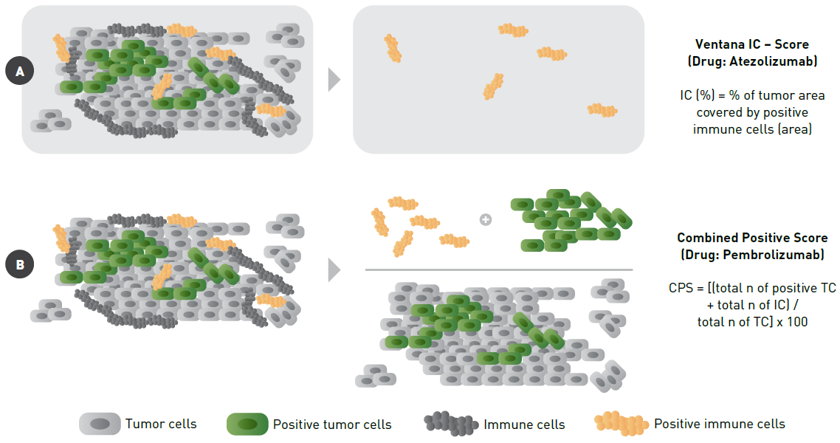

Slide 23
The PD-L1 IHC 22C3 pharmDx assay generates a combined positive score (CPS) by measuring PD-L1 expression in both the tumor cells and tumor-infiltrating immune cells.
This score is required to assess first-line treatment eligibility with pembrolizumab and chemotherapy in patients with metastatic TNBC; patients are eligible if they meet or exceed the cutoff of 10.

Slide 25
Tumor mutational burden (TMB), microsatellite instability (MSI), and mismatch repair deficiency (dMMR)
TMB, MSI, and dMMR should be performed if there is sufficient tissue.
However, if needed, these assessments can instead be performed in a subsequent biopsy after progression, given that they will not dictate choice of initial therapy and that these abnormalities are relatively rare in breast cancer.

Slide 26
In addition to these assays performed on tissue biopsy, all patients with TNBC should undergo genetics evaluation to determine if they are BRCA carriers, given the therapeutic implications in advanced disease.

Slide 27
Initial treatment for rapidly progressive visceral disease
Combination chemotherapy may be appropriate for those with extensive or rapidly progressive visceral disease, in whom the higher chance of response is thought to outweigh the higher risks of toxicity, due to concerns about impending organ dysfunction.
However,there are no prospective data that show combination chemotherapy improves overall survival (OS) compared with single-agent sequential cytotoxic chemotherapy.

Slide 28
Initial treatment in the absence of rapidly progressive visceral disease

Slide 29
PD-L1-negative tumors
single-agent chemotherapy
combination chemotherapy strategies may be appropriate in some patients with rapidly progressive visceral disease
Either platinum- or non-platinum-based regimens are appropriate, with a choice driven by toxicity profiles.

Slide 30
PD-L1-positive tumors
addition of an immune checkpoint inhibitor to chemotherapy
The checkpoint inhibitor atezolizumab is FDA approved for use with nabpaclitaxel for those with advanced TNBC with PD-L1-stained, tumor-infiltrating immune cells of any intensity covering ≥1 percent of the tumor area, based on observed benefits in OS.

Slide 31
PD-L1-positive tumors
Additionally, pembrolizumab is approved in combination with chemotherapy for patients with metastatic TNBC whose tumors express PD-L1 with a Combined Positive Score (CPS) ≥10.
This is a reasonable alternative to atezolizumab and nabpaclitaxel, particularly for those in whom a taxane may not be preferable, eg, those with poor tolerance of previous taxane therapy or with a short interval of progression from prior taxane (ie, <12 months). However, OS data have not yet been reported for this approach.

Slide 32
Although these therapies are approved irrespective of treatment line, the supporting data were based on patient experiences receiving first-line treatment for metastatic disease. The benefits as later-line treatment for metastatic disease are not known.
Recognizing this limitation, patients with prior taxane treatment (either in the [neo]adjuvant or metastatic setting) are still candidates for the atezolizumab/nabpaclitaxel combination.

Slide 33
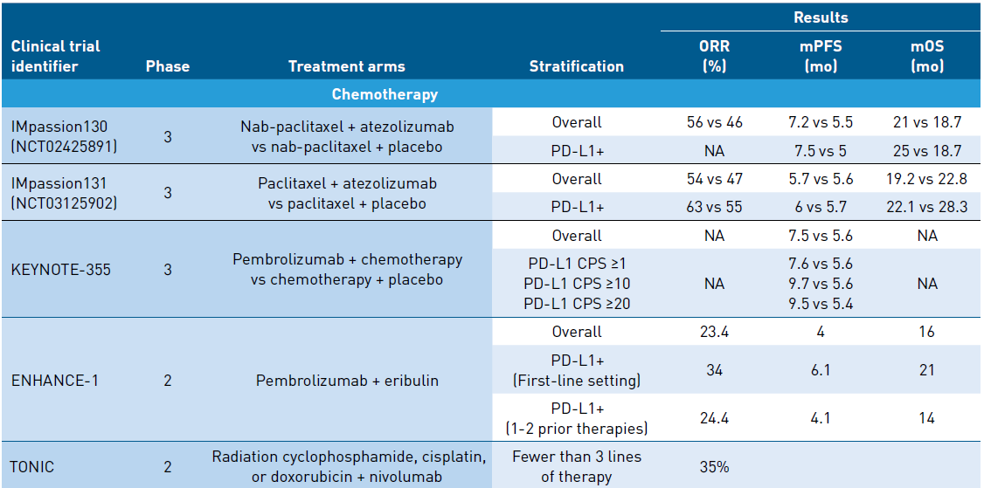
Phase III first line metastatic immunotherapy + chemotherapy

Slide 34
IMpassion 130 trial
902 patients who had not received treatment for metastatic TNBC were randomly assigned to nabpaclitaxel with either atezolizumab or placebo
Overall, at a median follow-up of 13 months, there was only a modest but statistically significant difference in progression-free survival (PFS) in favor of incorporating atezolizumab.
PFS for those receiving atezolizumab versus those who did not was 7.2 versus 5.5 months , with a nonsignificant trend towards improved OS (21.3 versus 17.6 months)

Slide 35
IMpassion 130 trial
However, in a prospectively planned subset analysis of outcomes according to PD-L1-expressing immune effector cells within the tumors, atezolizumab improved both PFS (7.5 versus 5 months), and, importantly, OS (25 versus 15.5 months).
Final OS analysis at 20 months' follow-up demonstrated continued improved survival in the PD-L1-positive subset with the addition of atezolizumab to nabpaclitaxel (18 versus 25 months) and similar adverse events, with 23 percent experiencing thyroid disease and approximately 10 percent with other immune-related adverse events.

Slide 36
IMpassion 131 trial
atezolizumab combined with paclitaxel in first-line metastatic TNBC, with a focus on PD-L1-positive tumors defined similarly to IMpassion 130
unlike IMpassion 130, no significant improvement in PFS in the PD-L1-positive subset was observed, at just under nine months' follow-up (5.7 versus 6 months).
The explanation for the discordance in results is unclear; however, given that the main difference between IMpassion 130 and 131 was the chemotherapy backbone, the preferred combination with atezolizumab remains nabpaclitaxel.

Slide 37
KEYNOTE 355
847 patients with locally recurrent, inoperable, or metastatic TNBC, all of whom had a disease-free interval of ≥6 months, were randomly assigned to chemotherapy (nabpaclitaxel, paclitaxel, or gemcitabine/carboplatin), with or without pembrolizumab.

Slide 38
KEYNOTE 355
Overall, there was a modest improvement in median PFS with the addition of pembrolizumab (7.5 versus 5.6 months).
Results were also stratified according to CPS that stain for PD-L1. These results suggest that benefit is limited to those with CPS ≥10, in whom the addition of pembrolizumab to chemotherapy improved median PFS by approximately two months (9.7 versus 5.6 months).

Slide 39
Germline BRCA mutation
Patients with previous exposure to chemotherapy
oral inhibitor of PARP rather than chemotherapy: the data suggest improved efficacy and fewer side effects.
However, chemotherapy is appropriate if and when a patient suffers progressive disease on a PARP inhibitor; or for those who are chemotherapy naive, having never received chemotherapy either in the early-stage or metastatic setting; or, for those with rapidly progressive visceral disease.

Slide 40
There is mechanistic rationale for use of PARP inhibition as anticancer therapy. PARP is involved in the molecular events leading to cell recovery from DNA damage.

Slide 41
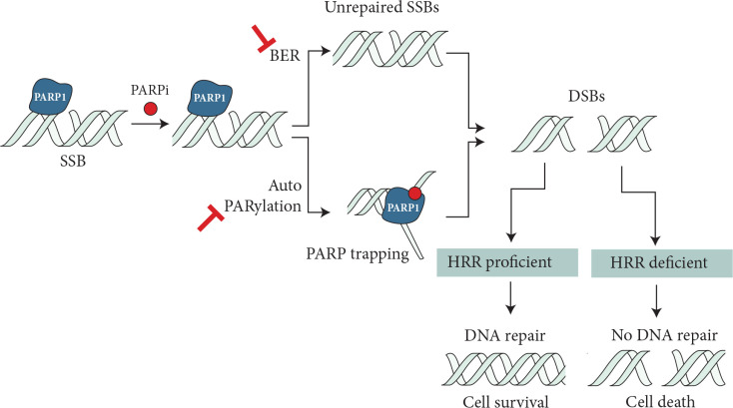
PARP inhibition impairs repair of single strain breaks (SSBs) by disrupting the base excision repair (BER) pathway and also causing PARP1 trapping by inhibiting auto-PARylation and/or PARP release from DNA. These result in unresolved DNA double-strand breaks (DSBs) that in homologous recombination repair (HRR)-deficient cells lead to cell death.

Slide 42
When PARP1, the most abundant member of the PARP family, is inhibited, double-strand DNA breaks accumulate and under normal conditions are repaired via the BRCA pathway-dependent homologous recombination mechanism.
Investigators hypothesized that inhibition of PARP, in combination with DNA-damaging chemotherapeutics, would render tumors lacking BRCA function exquisitely sensitive.

Slide 43
Pivotal Phase III studies of poly adenosine diphosphate ribose polymerase inhibitors in patients with germline BRCA1/BRCA2 mutations

Slide 44
OlympiAD trial
Among the subset of 121 BRCA mutation carriers with metastatic triple-negative disease, all of whom had received an anthracycline and a taxane in either the adjuvant or metastatic setting, those randomly assigned to olaparib experienced an improved PFS relative to those receiving chemotherapy.
The overall study, which also included those with hormone receptor-positive, HER2-negative disease, was also positive, but the improvements noted with olaparib were stronger in the triple-negative population.

Slide 45
EMBRACA trial
In the TNBC subgroup of the EMBRACA trial, which also enrolled patients with advanced breast cancer and a germline BRCA mutation , talazoparib improved PFS relative to single-agent chemotherapy.

Slide 46
There are several other PARP inhibitors in clinical development. For example, veliparib (ABT-888) was tested in combination with temozolomide, an alkylating agent, among 41 women with advanced TNBC (of whom 8 had aBRCA germline mutation) in a single-arm phase II study.
While the overall response and clinical benefit rates were 7 and 17 percent across the entire study population, any activity appeared to be concentrated among the patients withBRCA mutations, in whom the overall response and clinical benefit rates were 37.5 and 62.5 percent, respectively.

Slide 47
Chemotherapy-naϊve patients, or those with progression on PARP inhibitors
Although treatment typically starts with a poly(ADP-ribose) polymerase (PARP) inhibitor for metastatic disease in those with germline BRCA mutations who have had chemotherapy in the (neo)adjuvant setting, chemotherapy is the preferred option for those who have never been exposed to chemotherapy (in the early or metastatic settings); or for those who have experienced progression on a PARP inhibitor; or for those with rapidly progressive visceral disease.

Slide 48
Chemotherapy :
●For the subset of patients with BRCA-associated breast cancers that also express PD-L1 : nabpaclitaxel/atezolizumab as the initial chemotherapy regimen, over other chemotherapy options.

Slide 49
Chemotherapy :
●For those with BRCA-associated, PD-L1-negative tumors, both platinums and taxanes are considered appropriate options for chemotherapy, with a choice driven by scheduling and toxicity considerations.
Guidelines from the American Society of Clinical Oncology have, however, suggested platinum agents over taxanes forBRCA1/2 carriers with advanced breast cancers.

Slide 50
The TNT randomized trial directly compared carboplatin and docetaxel in the first-line treatment setting for women with metastatic TNBC. Overall response rates were similar in the overall group, but among the 43 women with a known BRCA1/2 mutation, carboplatin resulted in a higher response rate (68 versus 33 percent; absolute difference 35 percent) and PFS (6.8 versus 4.4 months; absolute difference 2.6 months).
However, the trial had a crossover design, and no statistically significant OS difference was seen (12.8 months, 95% CI 10.6-15.3; and 12 months, 95% CI 10.2-13) for those allocated carboplatin or docetaxel, respectively, suggesting that either agent may be administered first, without compromising outcomes.

Slide 51
Sacituzumab govitecan
Trop-2 is expressed in the majority of TNBCs. Sacituzumab govitecan is an antibody-drug conjugate that targets Trop-2 for the selective delivery of SN-38, the active metabolite of irinotecan. It is approved by the FDA for the treatment of adult patients with metastatic TNBC who have received at least two prior therapies for metastatic disease.
Severe neutropenia and diarrhea may occur with this agent, including cases of neutropenic colitis.

Slide 52
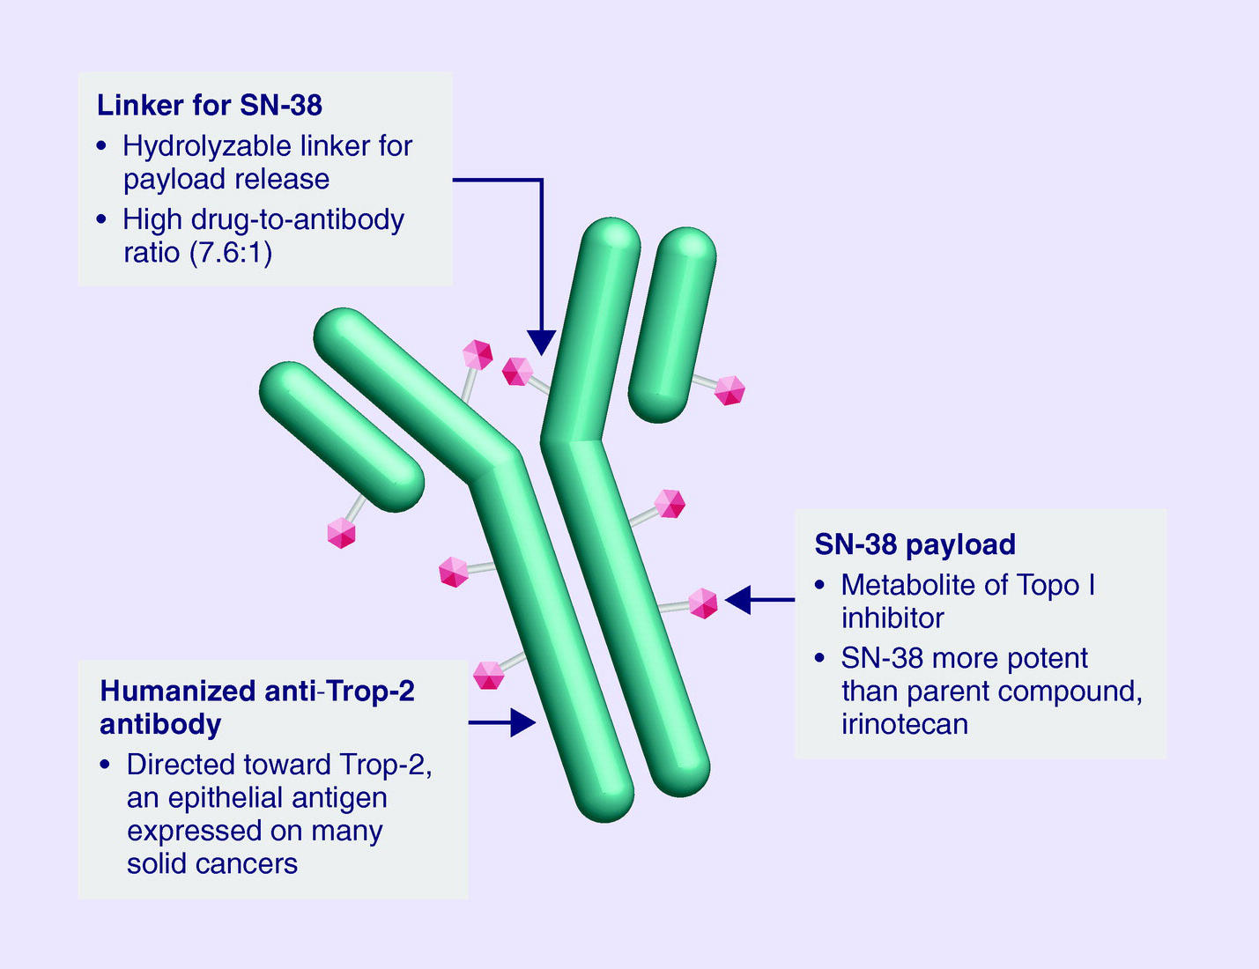

Slide 53
In a single-arm trial of 108 patients with previously treated metastatic TNBC (median of three previous treatments), the objective response rate to sacituzumab govitecan was 34 percent, with a median PFS of 5.5 months, duration of response of 9.1 months, and OS of 13 months. Grade ≥3 adverse events included neutropenia (42 percent), leukopenia (11 percent), anemia (11 percent), and diarrhea (8 percent).

Slide 54
ASCENT study
A randomized phase 3 study of sacituzumab govitecan (n = 267) vs treatment of physician’s choice (n = 262) in patients with previously treated metastatic TNBC
Patients had received at least 2 prior lines of treatment prior to enrolment.
The primary outcome was investigator assessed PFS in the brain metastases free population. Progression free survival was significantly prolonged in the investigation arm with a PFS (5.6 mo vs 1.7 mo, HR 0.41, P < 0.0001).

Slide 55
ASCENT study
Median OS was significantly prolonged with SG (12.1 mo vs 6.7 mo, HR 0.48, P < 0.0001).
The most common grade 3 or 4 adverse events with SG were diarrhoea (10%), anaemia (8%) and leukopenia (10%).
Only 4.7% of patients discontinued the drug due to toxicity and there was no treatment related deaths.

Slide 56
Pembrolizumab for tumors with high TMB or MSI-H/dMMR tumors
The immune checkpoint inhibitor pembrolizumab is approved by the FDA for the treatment of unresectable or metastatic, microsatellite instability-high (MSI-H) or mismatch repair-deficient (dMMR) solid tumors, as well as tumors with high tumor mutational burden (TMB;≥10 mutations/megabase), that have progressed following prior treatment and that have no satisfactory alternative treatment options.

Slide 57
The trials supporting the approval of pembrolizumab for these indications did not include breast cancer patients, but efficacy was demonstrated in other cancer types, including cervical, endometrial, and ovarian cancer.

Slide 58
INVESTIGATIONAL OPTIONS
Several promising treatment options are under active clinical investigation but should not be used at this time outside of a clinical trial.

Slide 59
Epidermal growth factor receptor inhibitors
The epidermal growth factor receptor (EGFR/HER1) is perhaps the most well-known protein overexpressed among TNBC for which several monoclonal antibodies and small-molecule inhibitors exist. To date, three phase II clinical trials have evaluated the efficacy of cetuximab, an anti-EGFR monoclonal antibody, in combination with chemotherapy in advanced TNBC and have shown it has only modest activity.
Similarly, trials of EGFR inhibitors have not shown clinical impact in TNBC. These are not recommended for treatment of TNBC.

Slide 60
Androgen receptor inhibitor
The androgen receptor (AR) is expressed in both normal and malignant breast tissue. While luminal, hormone receptor-positive breast cancers more commonly express AR (91 percent), TNBC expresses AR approximately 30 percent of the time.
Interestingly, prognosis for those with AR-positive TNBC has been shown to be more favorable than those with non-AR-positive TNBC.

Slide 61
Androgen receptor inhibitor
One study reported six-month clinical benefit rate (CBR) of 19 percent (95% CI 7-39 percent) for the AR antagonist bicalutamide among 50 patients (12 percent of 424 screened) with metastatic AR-positive TNBC.

Slide 62
Androgen receptor inhibitor
The potent AR inhibitor enzalutamide was evaluated among 118 patients with AR-positive metastatic TNBC (55 percent of 404 screened). Two complete responses and five partial responses were observed. CBR at 16 weeks was 35 percent (95% CI 24-46), and was 39 percent (95% CI 27-53) among those whose tumors expressed an AR-driven gene signature.

Slide 63
Angiogenesis inhibitor
To date, prospective studies have not shown that incorporation of angiogenesis inhibitors has an impact on overall survival (OS) for women with TNBC.
Of agents in this class, bevacizumab has been the most widely studied. Unfortunately, data consistently show that while incorporation of bevacizumab can improve PFS, there is virtually no impact on OS. This appears to be true even for patients with TNBC when bevacizumab was administered in the adjuvant and first-line metastatic settings.

Slide 64
Ipatasertib
The protein kinase B (AKT) pathway is commonly mutated in solid organ tumours playing a crucial role in cell survival and growth.
Ipatasertib is a potent AKT pathway signalling inhibitor which has demonstrated tolerability and antitumour activity in early clinical studies.

Slide 65
The LOTUS trial investigated ipatasertib in 124 patients in a randomised phase 2 study of ipatasertib/paclitaxel vs placebo/paclitaxel as first-line therapy for TNBC. In the overall population, the median PFS was enhanced with ipatasertib (6.2 mo vs 4.9 mo, HR =0.6, P = 0.037).

